Slide 1
Trigger
%macro check_trigger_run;
/*Trigger No1: If trigger file exists then cease all work.*/
%let fname="&path2trigger\Report_Trigger_&ym..csv";
%let _trigger=%sysfunc(fileexist(&fname.));
%if &_trigger. = 1 %then %put file exists before code runs. Cease all work.;
%else %do;
/* Trigger file dose not exist. Start running the project codes.*/
/* Trigger No 2: Check if data is available */
proc sql;
connect to odbc(dsn='xxxxxxxx');
create table sample as
select * from connection to odbc
(select top 100 *
from serverlib.monthly_data
where data_month = &prior_month.);
disconnect from odbc;
quit;
proc sql noprint;
select count(*) into :data_count from sample;
quit;
%if &data_count = 100 %then %do; ………; %end;
%end;
%mend;
%Check_trigger_run;
%macro save_trigger;
%if (&_trigger. = 0 and &data_count = 100) %then %do;
Data trigg; data_available = 1;run;
proc export data=trigg dbms=csv outfile="&path2trigger\Report_Trigger_&ym..csv"; run;
%end;
%mend;
%save_trigger;

Slide 2
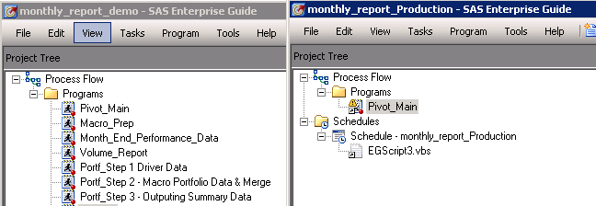
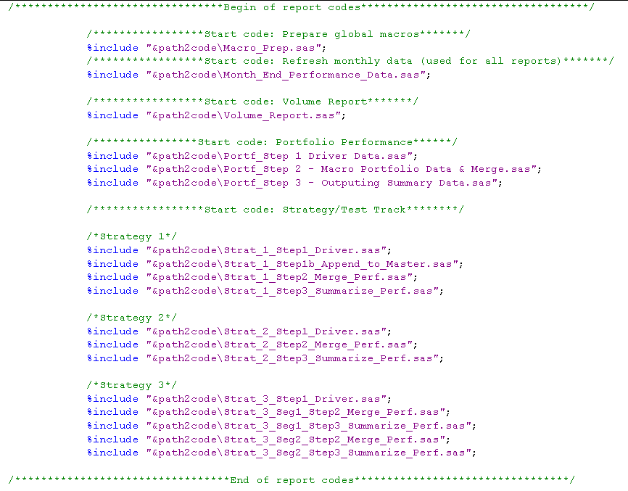
Main Code Module
Project 'Demo' – for editing & debugging
Project 'Production' – for running
Same thing!
Use %include to arrange long codes to a better view

Slide 3
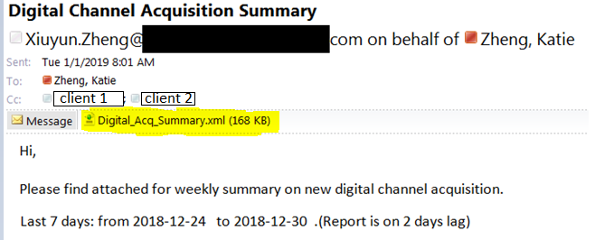
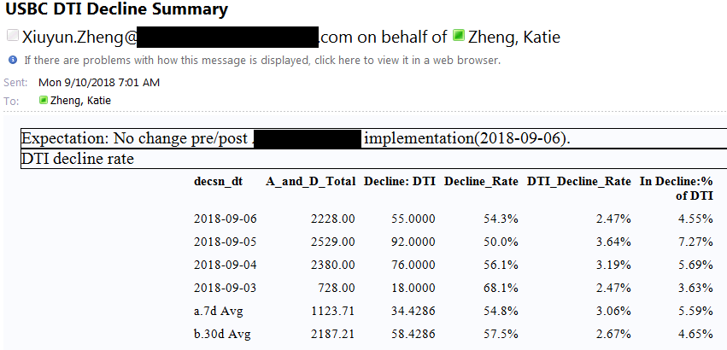
Email Output
Email with attachment -
Email with content only -

